Slide 1

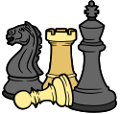
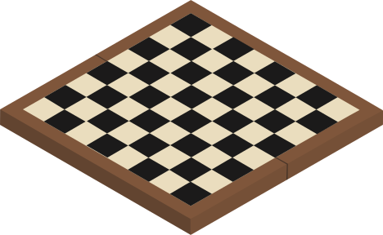

DATA STRUCTURE ALGORITHM
Chess Project

Slide 2
Group Members and Contributions:
1) Nguyễn Hoàng Phúc - ITITWE21082:25%
2) Nguyễn Ngọc Bảo Hân - ITITWE21069:25%
3) Võ Nguyên Thành Liêm - ITITIU21069:25%
4) Phạm Thái Quốc - ITITDK21050:25%

Slide 3
CONTENT
INTRODUCTION

Slide 4
CONTENT
INTRODUCTION
GAME RULES

Slide 5
CONTENT
INTRODUCTION
GAME RULES
CLASS DIAGRAMS

Slide 6
CONTENT
INTRODUCTION
GIT EXPLANATION
GAME RULES
CLASS DIAGRAMS

Slide 7

CONTENT
INTRODUCTION
GIT EXPLANATION
GAME RULES
LECTURE APPLICATIONS
CLASS DIAGRAMS

Slide 8
CONTENT
INTRODUCTION
GIT EXPLANATION
GAME RULES
LECTURE APPLICATIONS
CLASS DIAGRAMS
LIMITATION

Slide 9
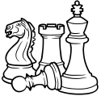
INTRODUCTION

Slide 10

INTRODUCTION
The Chess game follows the basic rules of chess, and all the chess pieces only moveaccording to valid moves for that piece. Our implementation of Chess is for two players (use of Artificial Intelligence). It is played on an 8x8 checked board, with a dark squarein each player's lower left corner

Slide 11

PIECES

Slide 12






PIECES
KING
QUEEN
BISHOP
KNIGHT
ROOK
PAWN

Slide 13













GAME RULES
8
7
6
CHESS
5
4
3
2
1
A
B
C
D
E
F
G
H

Slide 14
2. GAME RULES

Slide 15


KING
Moves one square in any direction.

Slide 16

QUEEN
Moves horizontally, vertically, or diagonally any number of squares.

Slide 17

BISHOP
Moves diagonally any number of squares.

Slide 18

KNIGHT
Moves in an "L" shape, can jump over pieces.

Slide 19
ROOK
Moves horizontally or vertically any number of squares.

Slide 20

PAWN
Moves forward one square, captures diagonally

Slide 21

3. CLASS DIAGRAM

Slide 22
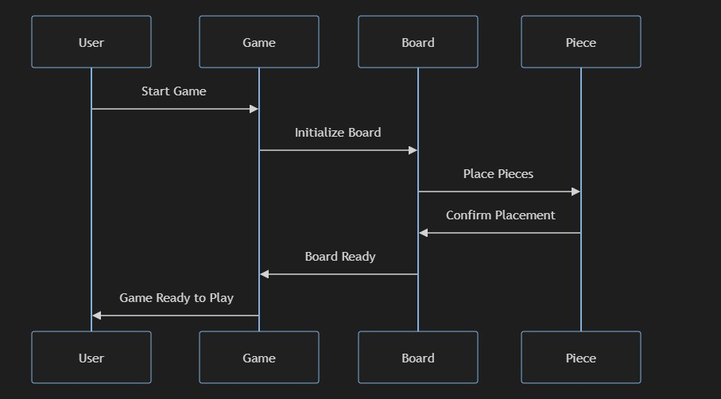
3. CLASS DIAGRAM

Slide 23

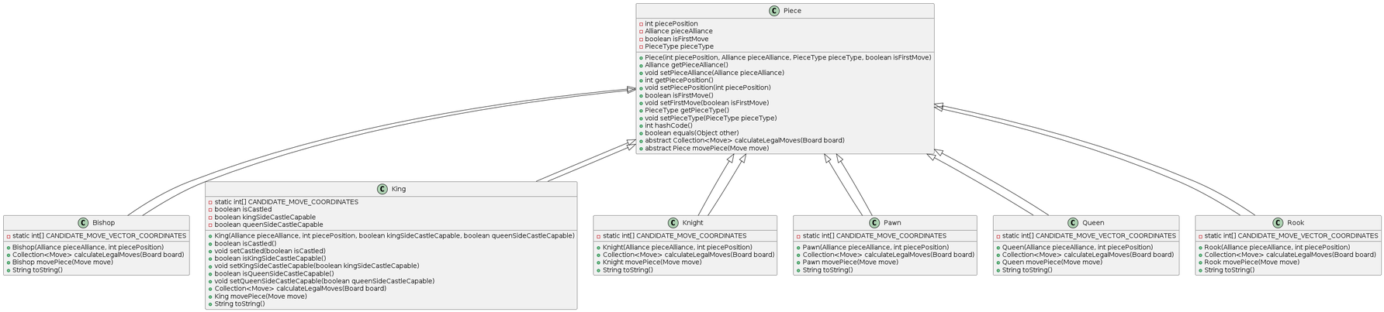
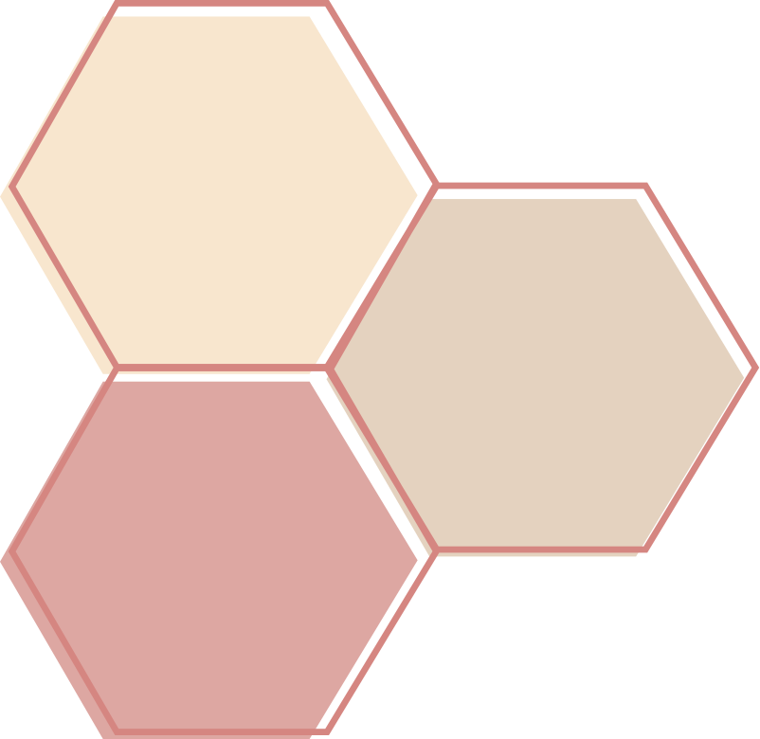

4. PIECE DIAGRAM

Slide 24
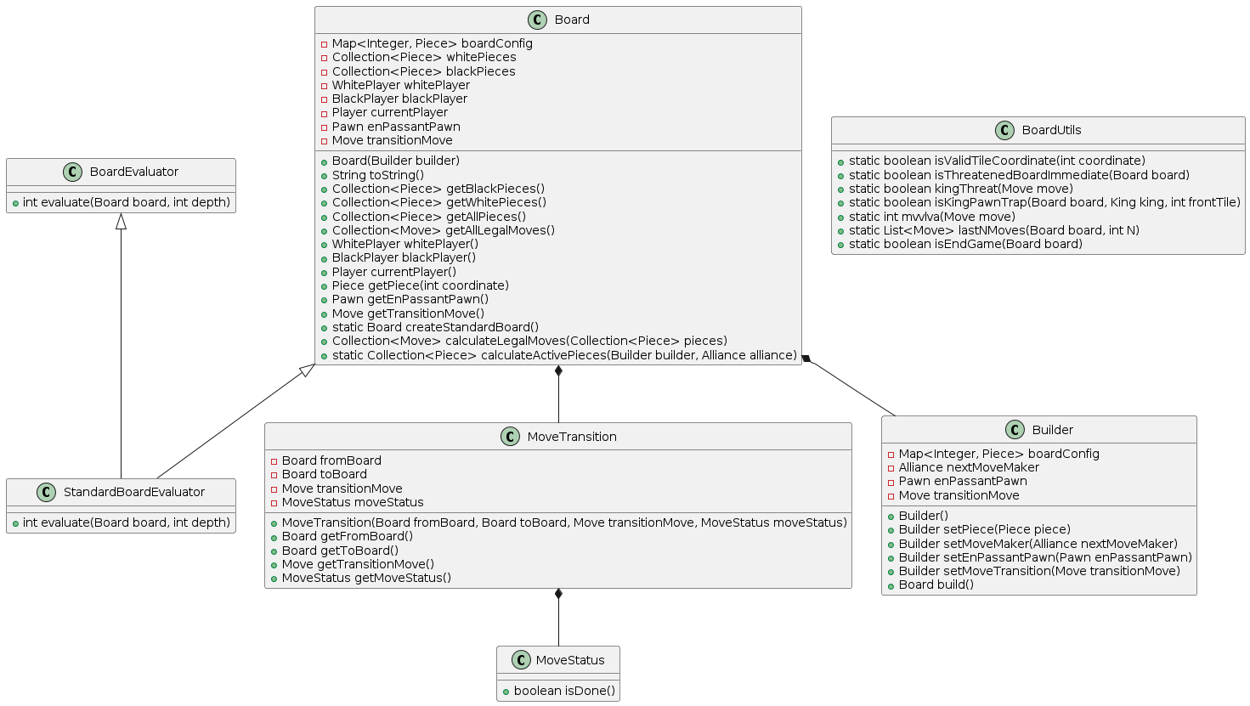
4. BOARD DIAGRAM

Slide 25
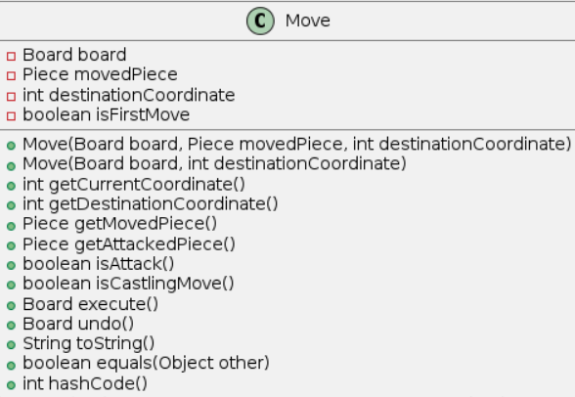
MOVE CLASS

Slide 26
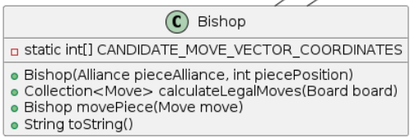
BISHOP CLASS

Slide 27
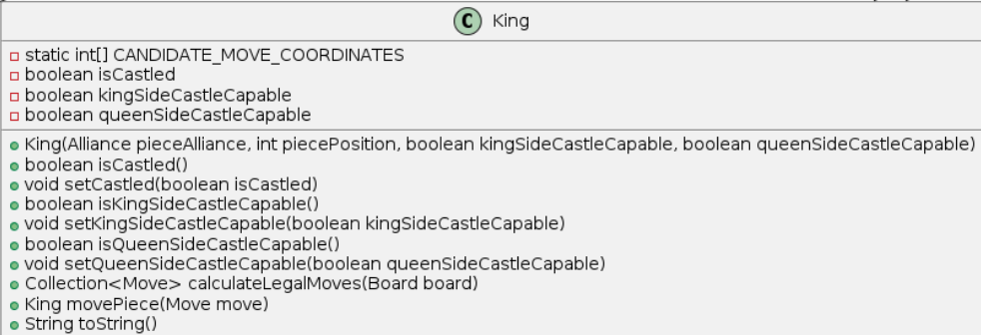
KING CLASS

Slide 28
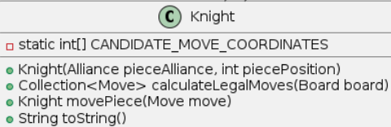
KNIGHT CLASS

Slide 29
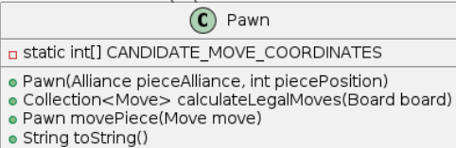
PAWN CLASS

Slide 30
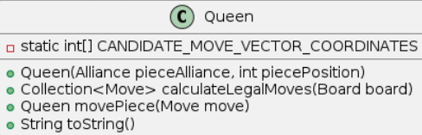
QUEEN CLASS

Slide 31
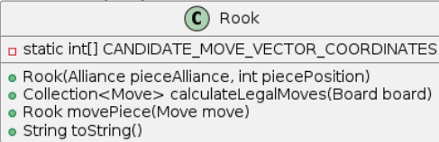
ROOK CLASS

Slide 32

4. GIT EXPLANATION

Slide 33
4. GIT EXPLANATION
Version Control
GitHub was used for source code management. The repository includes:
● Branches: Separate branches for different features and bug fixes.
● Commits: Regular commits with descriptive messages.
● Pull Requests: Used for code reviews and merging changes into the main branch.
Collaboration
Multiple contributors worked on different aspects of the project, using Git for version control to ensure seamless collaboration and integration of changes.

Slide 34

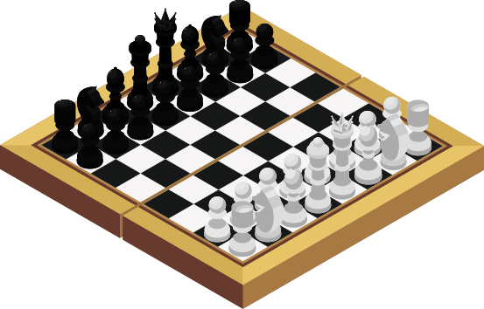
5. LECTURE APPLICATION
This project applies various concepts learned in lectures, including:
● Data Structures: Arrays, linked lists, and hash maps to manage game state and piece positions.
● Algorithms: Minimax and alpha-beta pruning for AI decision-making.
● Object-Oriented Programming (OOP): Design patterns, encapsulation, inheritance, and polymorphism to create a modular and maintainable codebase.

Slide 35


6. LIMITATION
Complexity In Design
Overhead of abstraction and managing dependencies can make the design more complex.
Performance Overheads
Increased memory usage and potential slowdowns due to abstraction layers.
Implementation Challenges:
Steep learning curve for developers and complexity in refactoring.
Scalability Issues:
Object and code bloat can occur as the system grows.
Integration with DSA:
Potential inefficiencies in integrating advanced algorithms and data structures with OOP.
Debugging and Testing:
Complex object interactions can make debugging and comprehensive testing more challenging.

Slide 36

7. TASKING
Nguyễn Ngọc Bảo Hân:
KingSafetyAnalyzer
PawnStructureAnalyzer
Võ Nguyễn Thanh Liêm:
Minimax
MoveOrdering
RookStructureAnalyzer
Phạm Thái Quốc:
AlphaBetaWithMoveOrdering
StandardBoardEvaluator
LegalMove via BitBoards.
Nguyễn Hoàng Phúc:
StockAlphaBeta
IterativeDeepening

Slide 37
FINAL APP GAME
LET'S PLAY
CHESS!

Slide 38


SOURCE CODE
https://github.com/gojous/OOP-DSAsemester2-2023-2024-

Slide 39
THANK YOU FOR LISTENING
LET'S PLAY
CHESS!

